Slide 1
ATM MACHINE PROJECT
- Harish Kumar L

Slide 2
Abstract
The ATM Machine is the project which is used to access their bank accounts in order to make cash withdrawals. Whenever the user need to make cash withdraws, they can enter their pin number (personal identification number) and it will ask user to enter how much money he/she wants to withdraw. Once their withdrawn was successful, The amount will be debited in their account and shows New Balance.
The ATM will service one customer at a time. A customer will be required to enter Customer Number (ATM card Number), personal identification number (PIN).
This Application supports two type of accounts for single user.
1. Checking Account
2. Saving Account
For Each type of account the user will be able to perform multiple options like View Balance, Withdraw, Deposit, Check Account Information.
This Application provides Transaction Data and Time in the beginning for Security purpose.

Slide 3
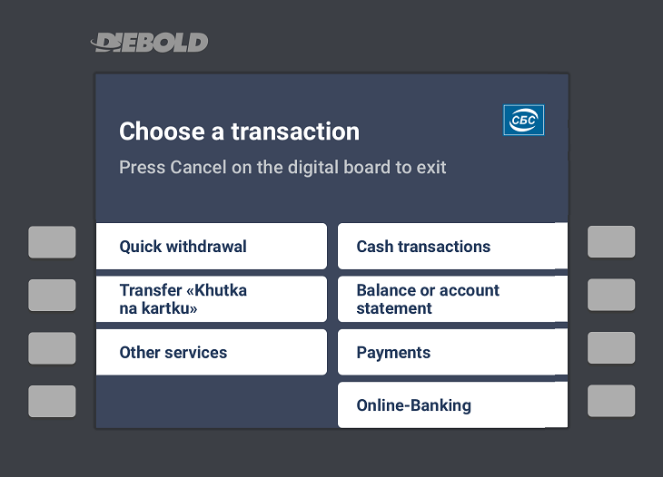
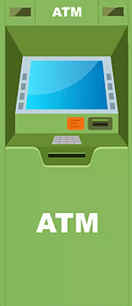
importance of ATM machine
These machines allow you to undergo self-serviced transactions without the help of an actual teller and without having to visit the bank branch. Automated teller machines or ATM’s allow many transactions, including cash withdrawals, cash deposits, and fund transfers.
The ability to access one's account 24/7 at multiple locations.
Customers can withdraw cash through an atm and no longer need to visit the bank to avail the service.
No need of Carrying check book and cash.
ATM is a Monitor based system, so it saves human resources, and it saves time.
Fixed Deposit can be done using ATM.

Slide 4
let’s move on to the code ☺

